Slide 1
Have an Elevated View for Future
How our data insights help you succeed

Slide 2
Introduction
QADG Consulting is an advanced analytics consulting company that uses data science techniques to help businesses find opportunities for growth. We tend to focus on up-and-coming areas close to but separate from major metropolitan areas. Not only does QADG identify these high-value growth areas, we take the client through every step of the new-business process.
Partners:
1. Qingling Ni - COO
2. Alexander Hughes - CMO
3. Doug Goldberg – CFO
4. Guo Li – Chief Data Scientist

Slide 3
Executive Summary
Based on our research, location is one of the most important factors in the success of Fitness and Health Club business, and the growing Food Truck industry
Data research methodology
We researched the historical MTA turnstile data to identify the up-and-coming areas based on foot traffic trends, focusing on areas that showed increases of multiple stations in a neighborhood
Once the trends are identified, we did further research on economic and real estate growth in those areas
Our analysis showed Long Island City neighborhood in Queens (commercial and residential), West Midwood neighborhood of Brooklyn between the H and J subway lines (commercial and residential), and Queens between the 111 St and 103-Corona St subway lines (residential) enjoyed average 10-15% of foot traffic increase over the last 2 years
We recommend Athletic Gym of NYC consider all 3 neighborhoods. The estimated annual revenue increase by adding one gym for AG NYC is $400,000 assuming $100 monthly membership, and gaining 20% of market share by being first mover
We recommend Eclectic Food Carts focus more on the Long Island City and West Midwood neighborhoods because of the commercial presence in the areas. The estimated annual income by adding one truck is $500,000

Slide 4
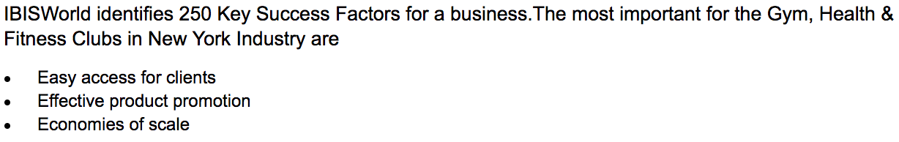
Fitness and Health Clubs are a convenience business
No. 1 success factor for fitness clubs in New York is easy access to clients
Members pay $10 to $50 more per month to go to a more conveniently located fitness gym
Athletic Gym of NYC already has a successful chain of boutique fitness centers in New York City, and are ready to expand to the outer boroughs
Source:
1. http://smallbusiness.chron.com/target-market-fitness-gyms-3354.html
2. https://www.ibisworld.com/industry/gym-health-fitness-clubs-in-new-york.html

Slide 5

Location with little competition is very important for food truck business
Identifying areas with increasing foot traffic is key, as the primary driver of success is location
Entering locations that have little competition allows your business to enjoy higher revenue, profit and market share
“Because of the food court areas located in almost all the shopping malls, the least revenue is generated by food trucks in nearby areas which consist of 12% of the total revenue. Coming after this, is the industrial and construction work sites where about 15% of the total sales take place. Other locations like event venues produce 18% of the total industry revenue. And the highest percentage of revenue is generated from random roadside locations and street corners which make up 55% of the total revenue. Random placements are the most profitable way of achieving more sales. These areas usually include residential or office-majority locations where there aren’t many restaurants nearby, which make food trucks an attraction for that place.”
Eclectic Food Carts of NYC is a small business that successfully runs food trucks and carts in Manhattan, and should also look to expand to the outer boroughs

Slide 6
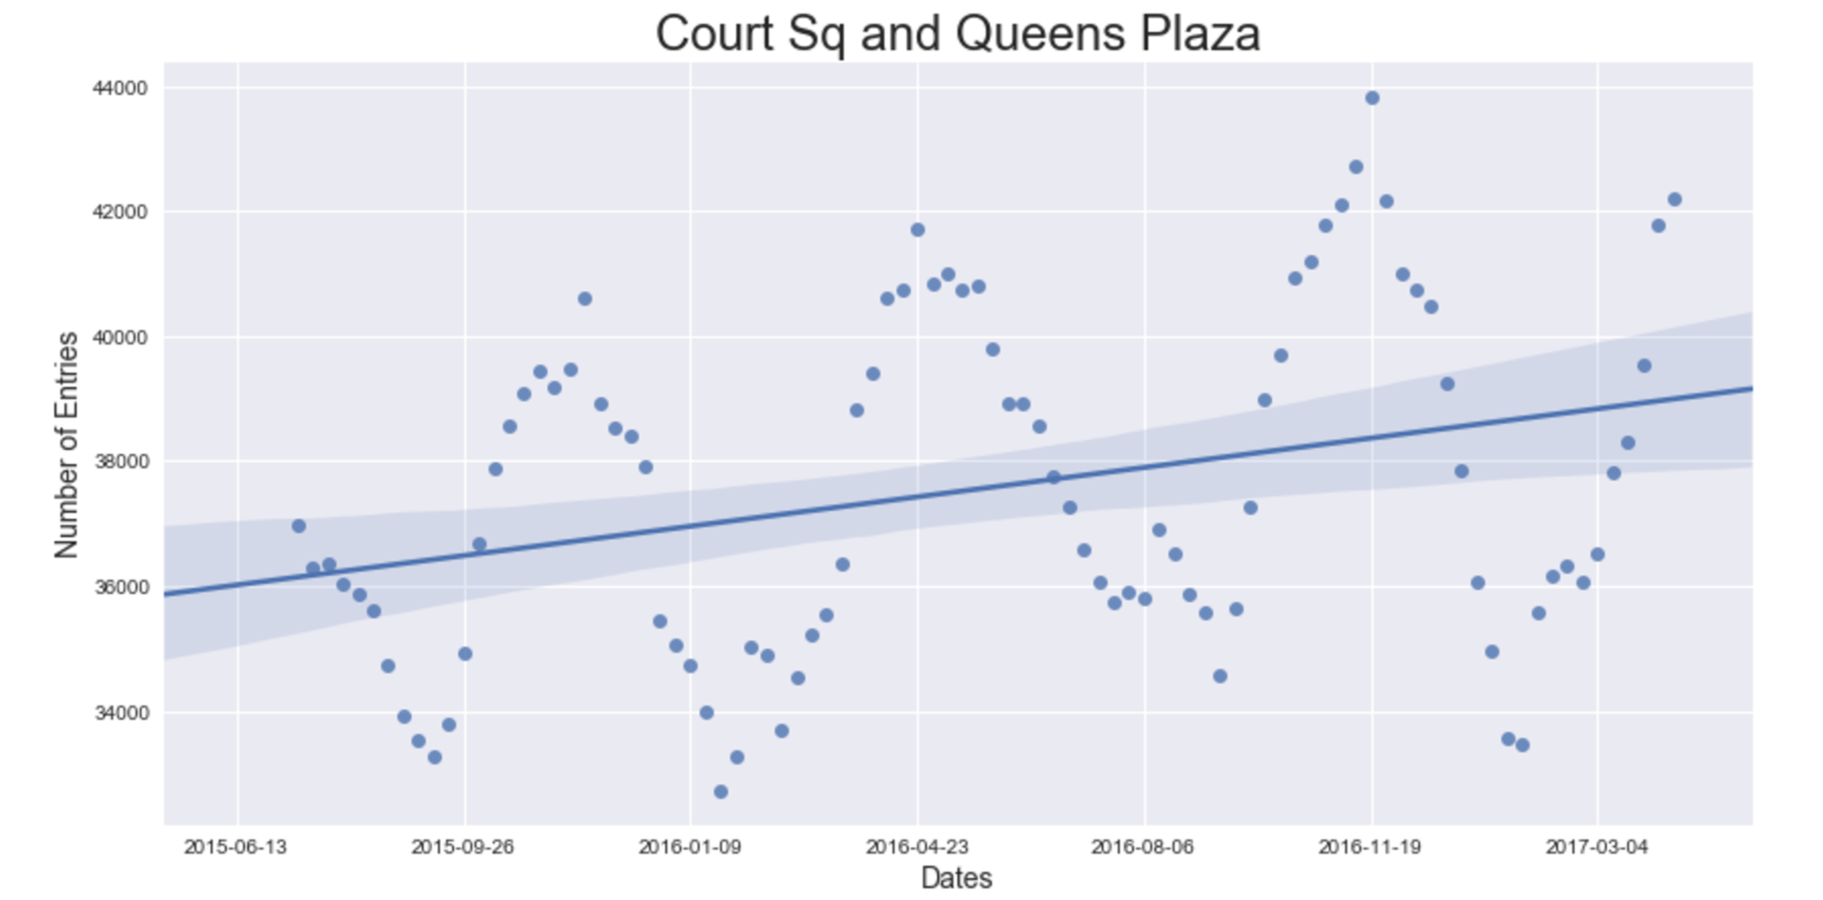
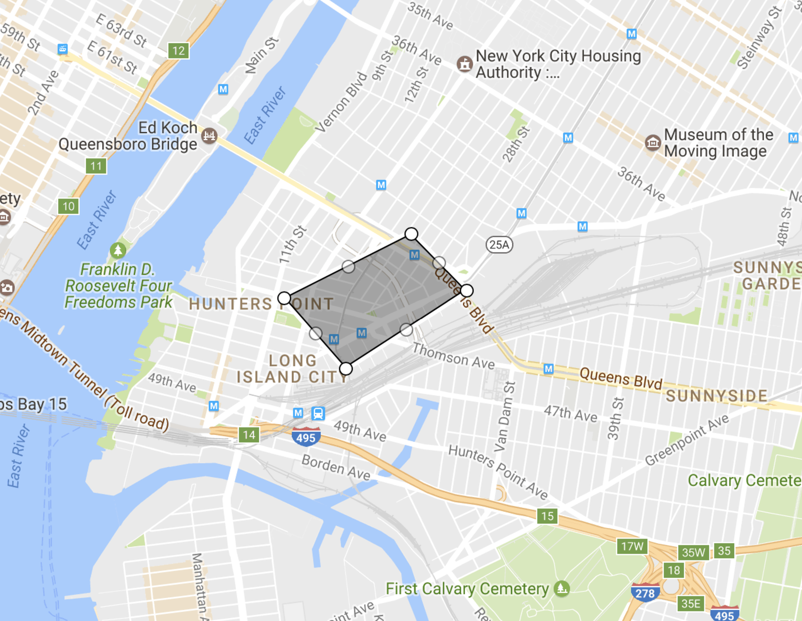
Long Island City, Queens
Average foot traffic increase of close to 10% over the last 2 years between the Court Square and Queensboro Plaza subway stations
Neighborhood has also seen a large real estate boom over the last 3 years, with the price increase of over 30%, a trend that is expected to continue through 2018
The average household income in the neighborhood is $71,000
As one resident said, “It’s definitely become the new ‘it’ neighborhood for Queens. Artists and families know they get more for their dollar than Brooklyn and Manhattan. It’s still gritty and cool with great value.”
The area would thus be an ideal location for both a new Athletic Gym of NYC studio and a series of Eclectic Food Trucks targeting both the residential parts of the neighborhood and the commercial area, that has also seen growth over the last two years

Slide 7
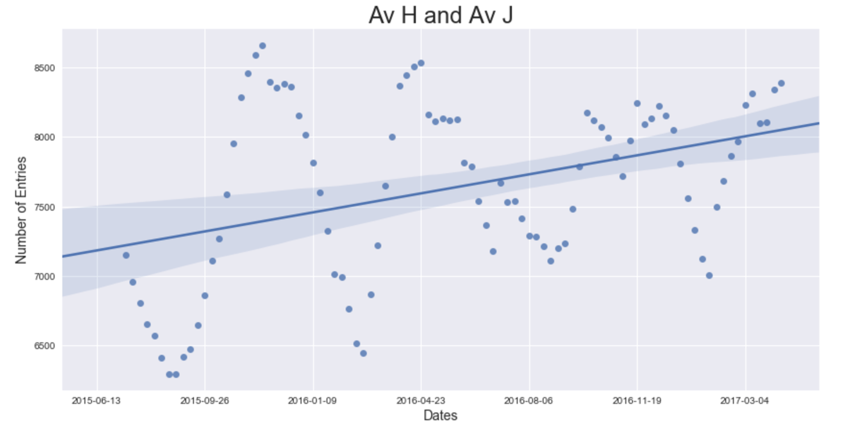
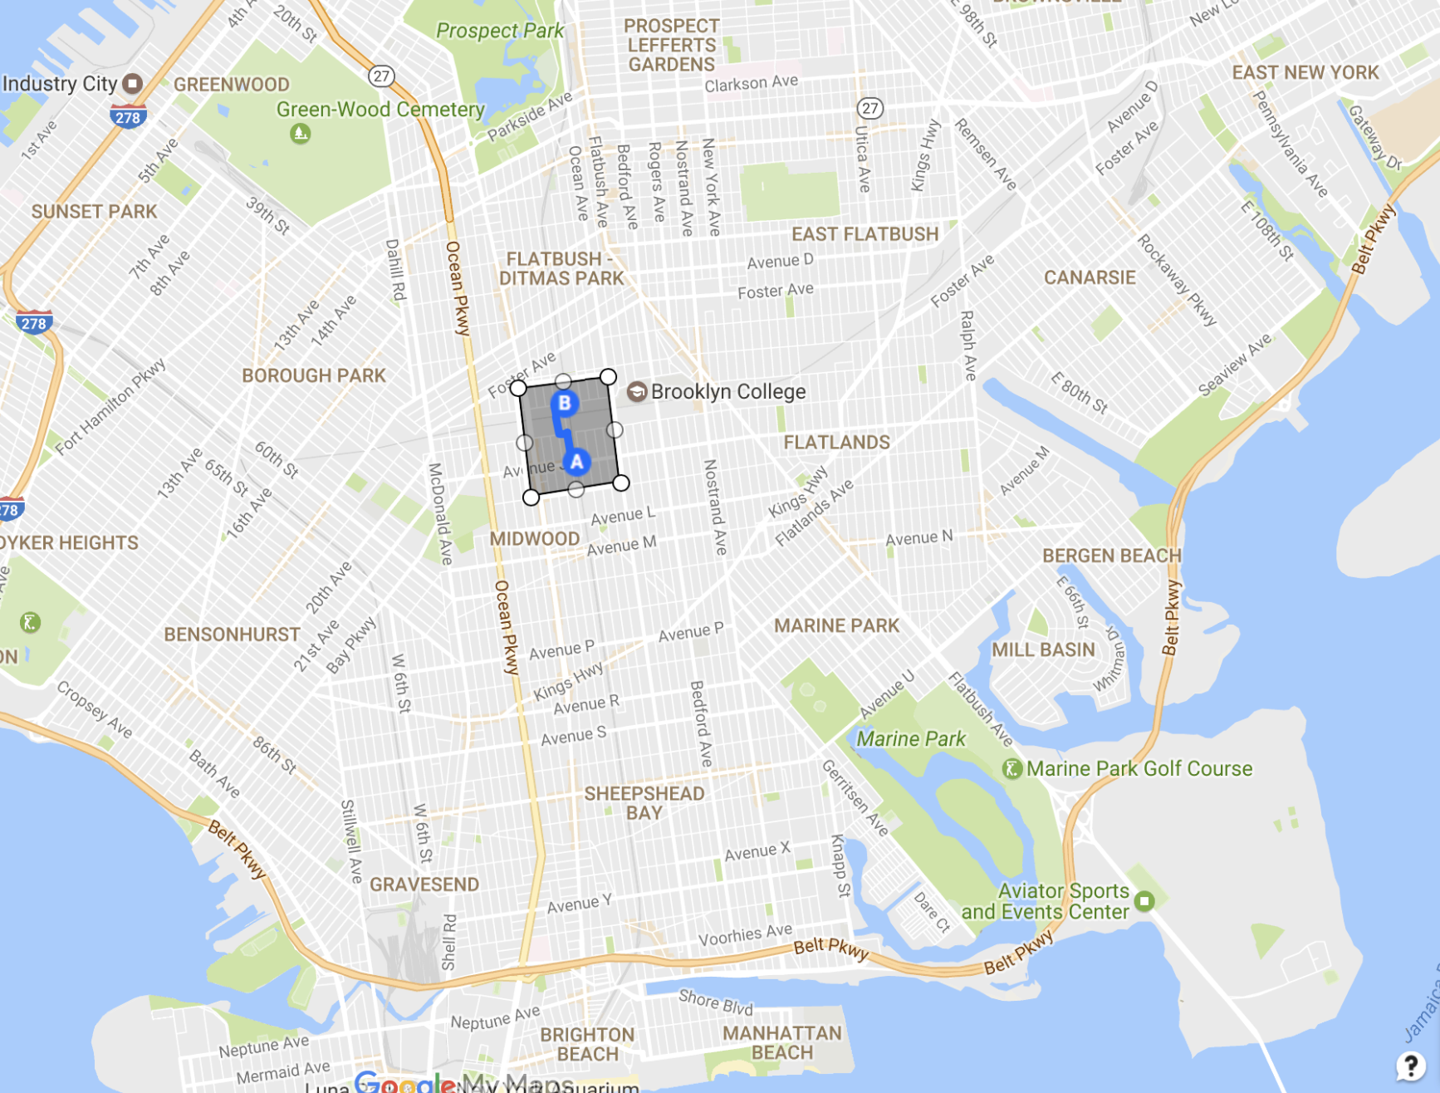
West Midwood, Brooklyn
Average foot traffic increase of 13% over the last 2 years between the AV H and AV J subway stations
Brooklyn as a whole has seen a 21% increase in businesses between 2003-2015 (highest in NYC) and a 28% growth in employment over that same time period
The average household income in the neighborhood is $67,000
West Midwood’s ideal location, just South of the Brooklyn Business District and near Brooklyn College, has made it ideal for the residential growth that we are seeing through the increased foot traffic through the subway system
A new Athletic Gym facility would be ideal between the two stations as would food trucks during lunch and afternoon commutes.

Slide 8
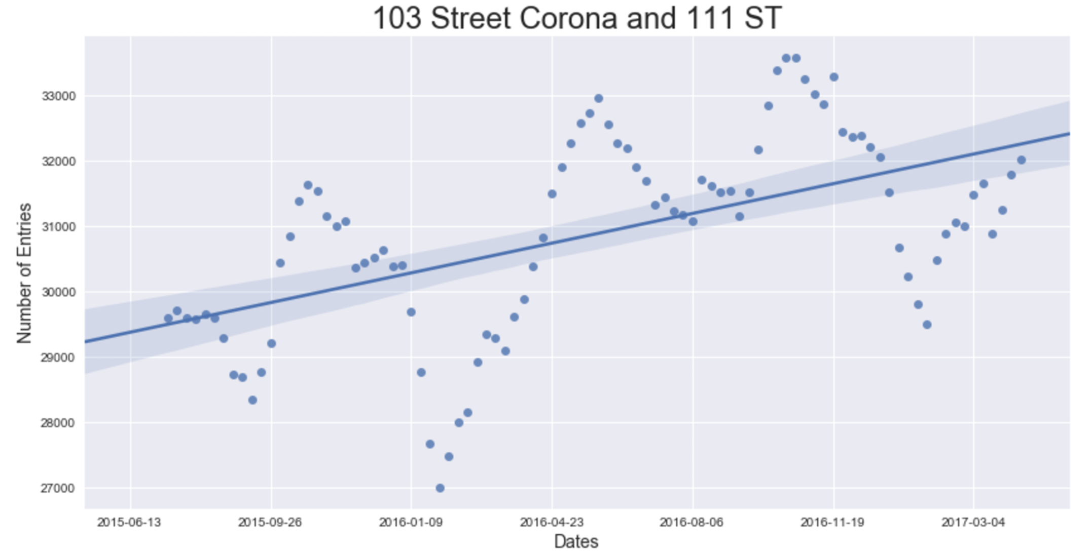
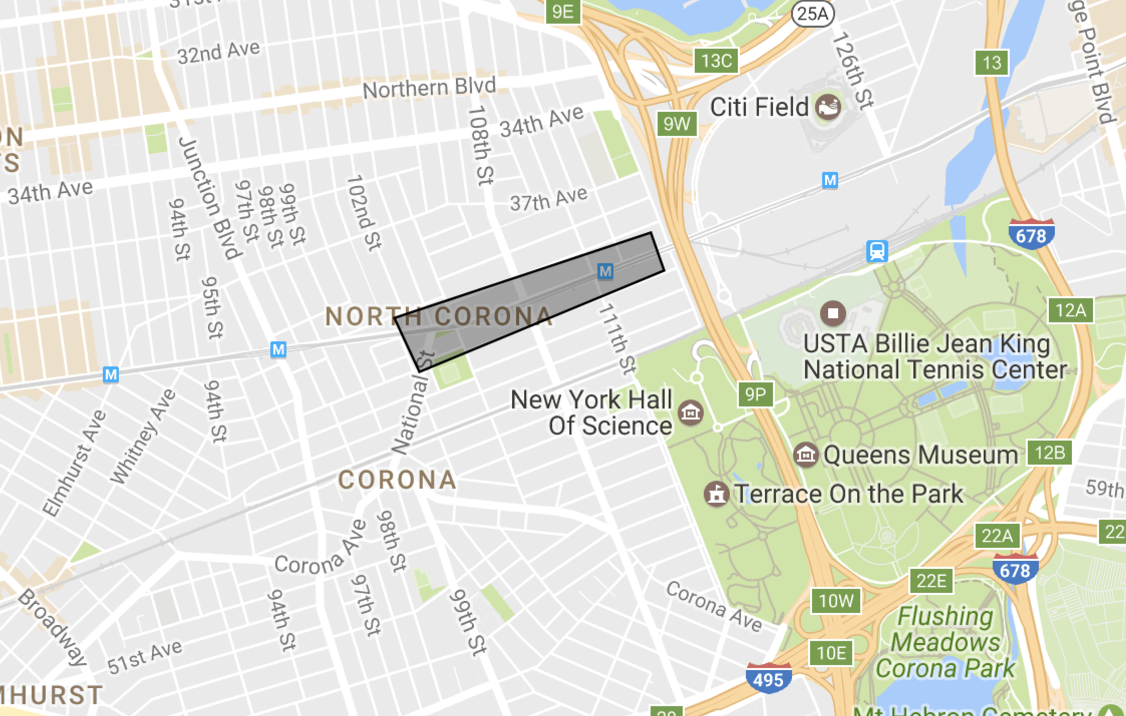
Corona, Queens
Average foot traffic increase of 11% over the last 2 years between 103 St Corona and 111 St subway stations
Housing data also supports this trend with median sales price and number of sales in the neighborhood almost doubling over the past 5 years
The Queens economy has continued to flourish with some predicting that Queens will become the next Brooklyn
Against this backdrop, the Corona area is ideal for the expansion of an Athletic Gym studio, and could even be a diamond in the rough for this community

Slide 9
Next Steps
The areas highlighted in Brooklyn and Queens have seen above average economic growth over the last few years and an ensuing increase in foot traffic as supported by our MTA turnstile data
As location and foot traffic is a primary business driver for both Athletic Gyms and Eclectic Food Trucks, these areas are ideal for the expansion of your businesses
With an agreement, QADG will continue its due diligence:
Demographic and population data
City zoning and permit data
Market specific prediction
Market entry strategy study
Other possible growth locations such as 116 St/Columbia University, and the Zerega Ave neighborhood in the Bronx

Slide 10
Appendix

Slide 11
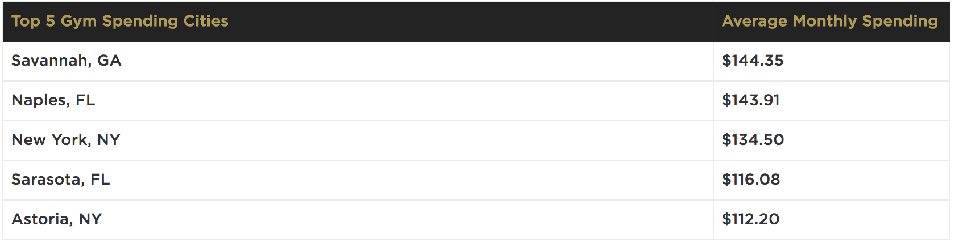
NYC Gym membership statistics
New York has a health club participation rate of 19.1 percent in 2011
Source:
1. http://www.statisticbrain.com/gym-membership-statistics/
2. http://www.huffingtonpost.com/2011/09/07/health-club-membership-by-state_n_951442.html?slideshow=true#gallery/189834/6

Slide 12
Food Truck Financial references
“ One truck owner still working his way up to profitability told us that to earn an owner a good salary, a truck would need to bring in upwards of $500,000 of revenue a year. Bobby confirmed this amount, describing $200,000 as an approximate break even point, the equivalent of “just making it into the major leagues.” Half a million per truck is doing quite well and a million dollars of revenue per year around the maximum for a single truck” – Priceconomics.com
Source:
1. https://priceonomics.com/post/45352687467/food-truck-economics

Slide 13
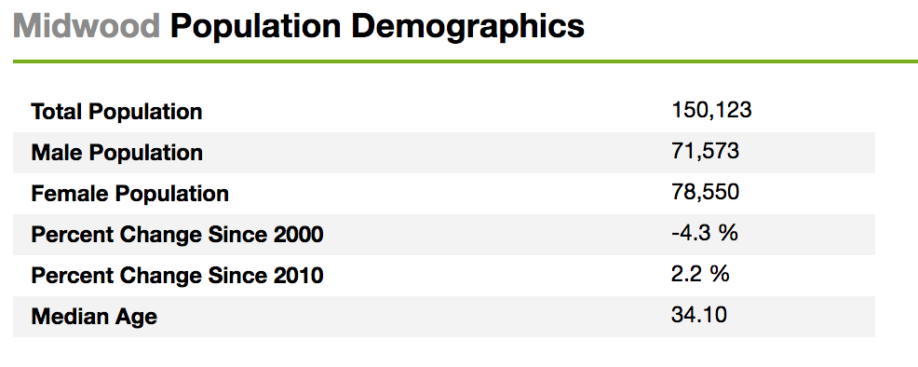
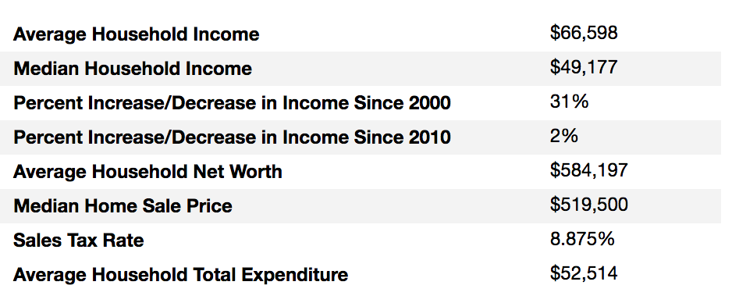
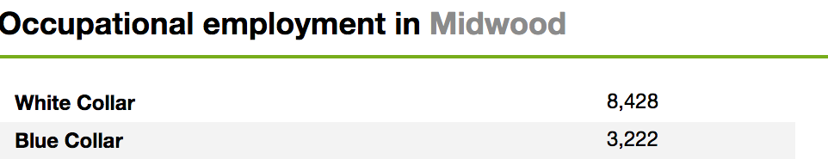
Midwood neighborhood info and statistics
“Midwood is a crazy combination of urban and suburban,” said Menachem Trietel, an agent at Weichert Realtors. Or as Alvin M. Berk, the chairman of Brooklyn Community Board 14, which includes parts of Midwood, put it: “Midwood is quiet and that’s how we like it.” The tree-lined streets of Midwood, with many single- and multifamily houses at prices that are relatively inexpensive for Brooklyn, naturally attract plenty of families – New York Times
Source: http://www.point2homes.com/US/Neighborhood/NY/Brooklyn/Midwood-Demographics.html

Slide 14
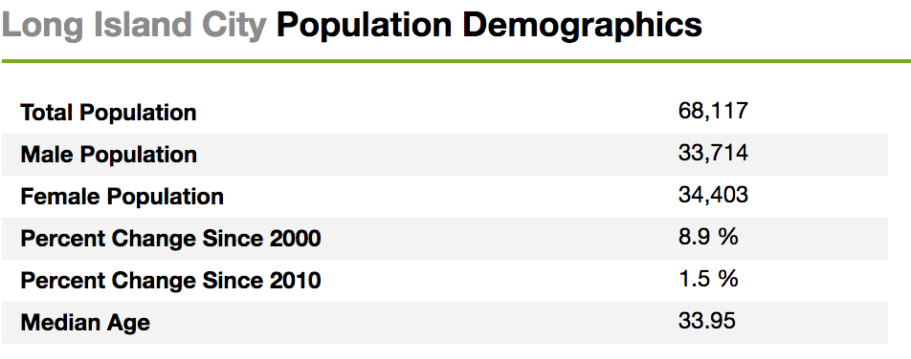
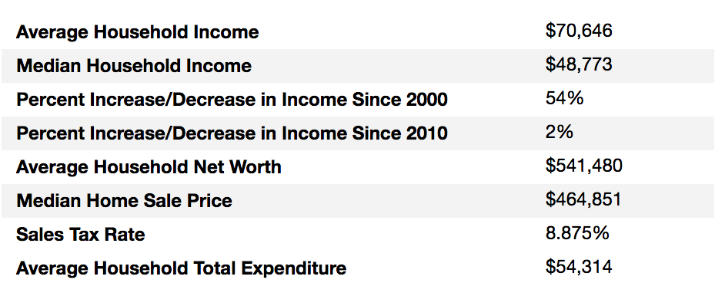
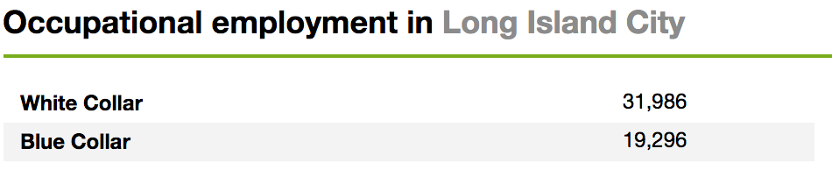
Long Island City neighborhood info and statistics
Long Island City (L.I.C.) is the westernmost residential and commercial neighborhood of the New York City borough of Queens. L.I.C. is noted for its rapid and ongoing residential growth and gentrification, its waterfront parks, and its thriving arts community.[1] L.I.C. has among the highest concentration of art galleries, art institutions, and studio space of any neighborhood in New York City. - Wikipeida
Source: http://www.point2homes.com/US/Neighborhood/NY/Queens/Long-Island-City-Demographics.html

